Slide 1
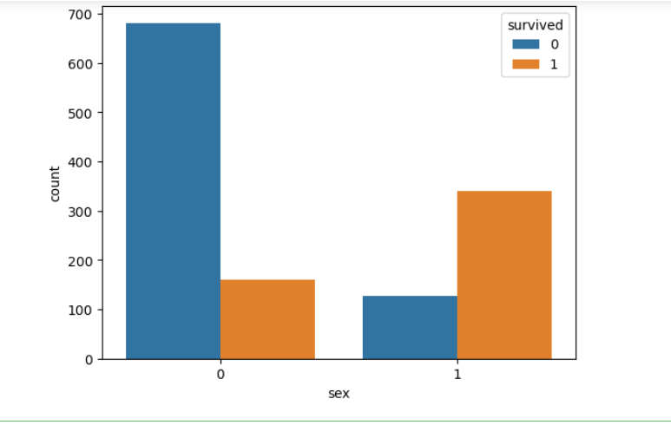
In Female More People Survived Than Death While In Men More People Died Than Survived . It Shows Women Have More Survival Rate

Slide 2
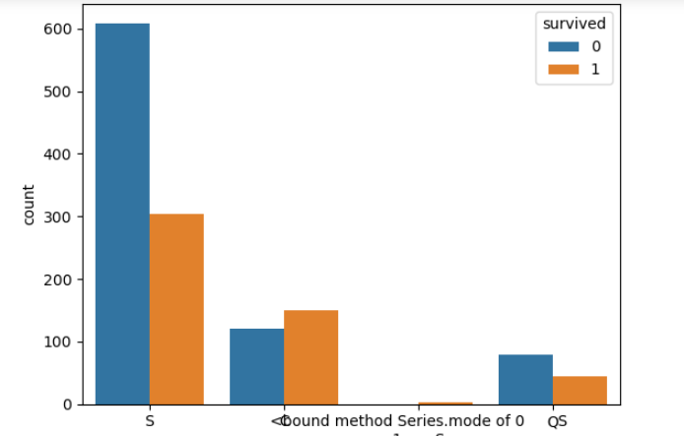
We Can See From This Graph Between Embarked And Survived Embarked C Have Less Death Rate Than S And Qs . So Embarked C Have More Survival Rate Than S And Qs

Slide 3
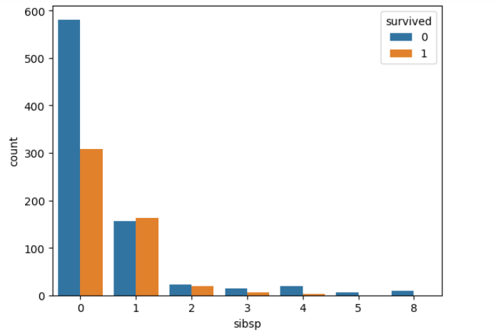
In This Graph Of Sibsp And Survived . We Can See Who Have 1 Sibling/Spouse Have More Survival Rate Than Than Any Other Number Of Sibling/Spouse

Slide 4
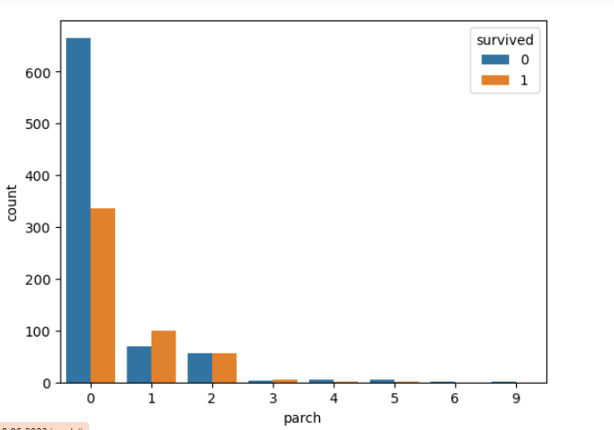
we can see from this Graph parch 1,2,3 have more survival rate than parch 0,3,4,5,6,9

Slide 5
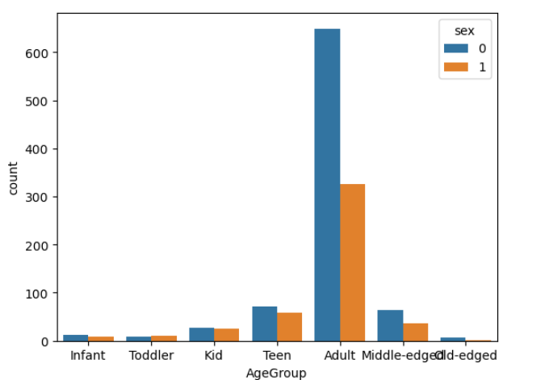
We Can See From This Graph Only Toddler Age Group More Females Than Males . While In All Other Age Group Male Is More Than Females

Slide 6
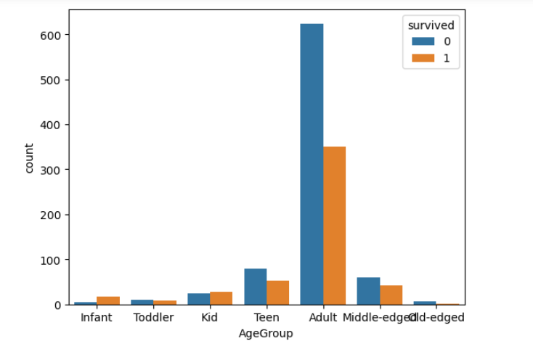
We Can See From This Graph Infant And Kid Have More Survival Rate Than Any Other Age Group. Then Followed By Toddler Then Any Other Age Group

Slide 7
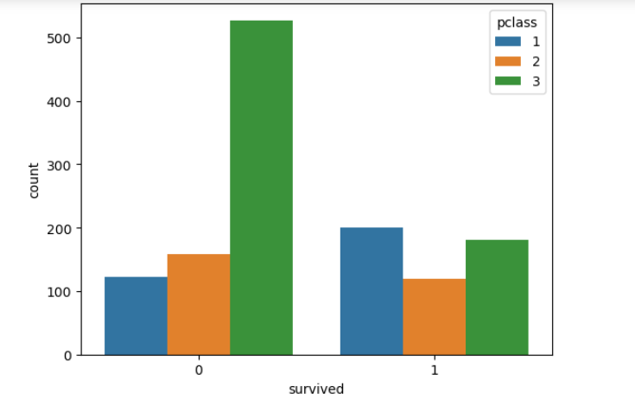
We Can Say Death Is More Predominant In 3rd Class Then 2nd Class And Then 1 St Class Means Lower Class Have More Death Rate

Slide 8
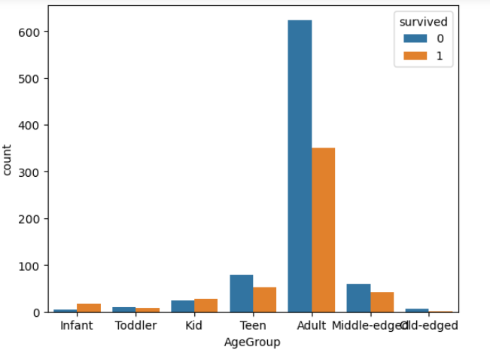
In Infant More People Survived Than Death. Kid Also Have More Survived Than Death

Slide 9
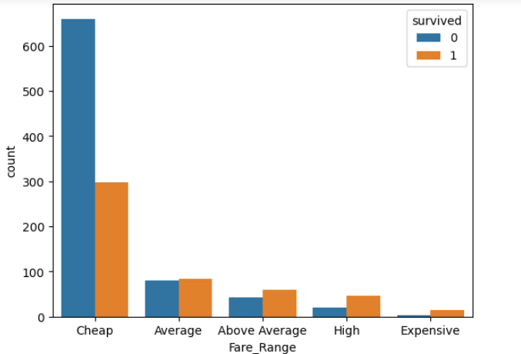
we can see from this graph people who travel from cheap fare range have lowest rate of survival. And we can also see as the fare range increases the survival rate increases. we can directly say from this graph expensive fare range have highest survival rate

Slide 10
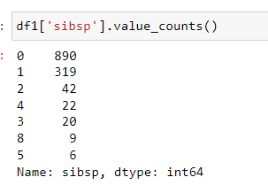
We Can See From This Counts Most People Do Not Have Any Siblings . As Count Of Sibling Increases No Of Person Have Sibling Decreases

Slide 11
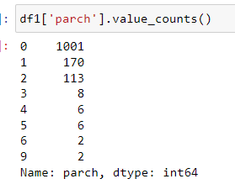
We Can See From This Counts Most People Does Not Go With Parent/Children In Titanic Ship . As Number of Children/Parent Travelling With The Person Increases No Of Person Having Children/Parent Decreases

Slide 12
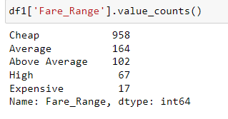
We Can See From This Counts Most People Travel In Titanic Ship In Cheap Fare Range As Fare Increases No Of People Travelling In That Fare Range Decreases

Slide 13
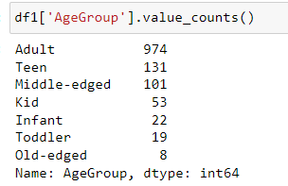
We Can See In This Counts Most People Who Travel In Titanic Are Adult And Teen . As The Age Decreases Or Increases The No Of People Travelling In That Age Group Decreases

Slide 14
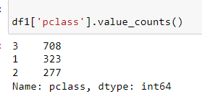
Most People In Titanic Was Travelled By Third Class Then First Class Then Second Class

Slide 15
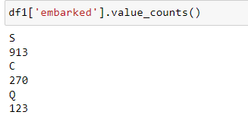
Most People In Titanic Mounted By Southampton Embarked Then Cherbourg Embarked And Last Queenstown Embarked

